Slide 1


An Internet of Things Sensors System – Early Detection System for Avocado Tree Diseases
By:
Bahaldeen Swied
Rabea Lahham Advisor:
Dr. Naomi Unkelos Shpigel
Project Code:
25-1-D-13

Slide 2
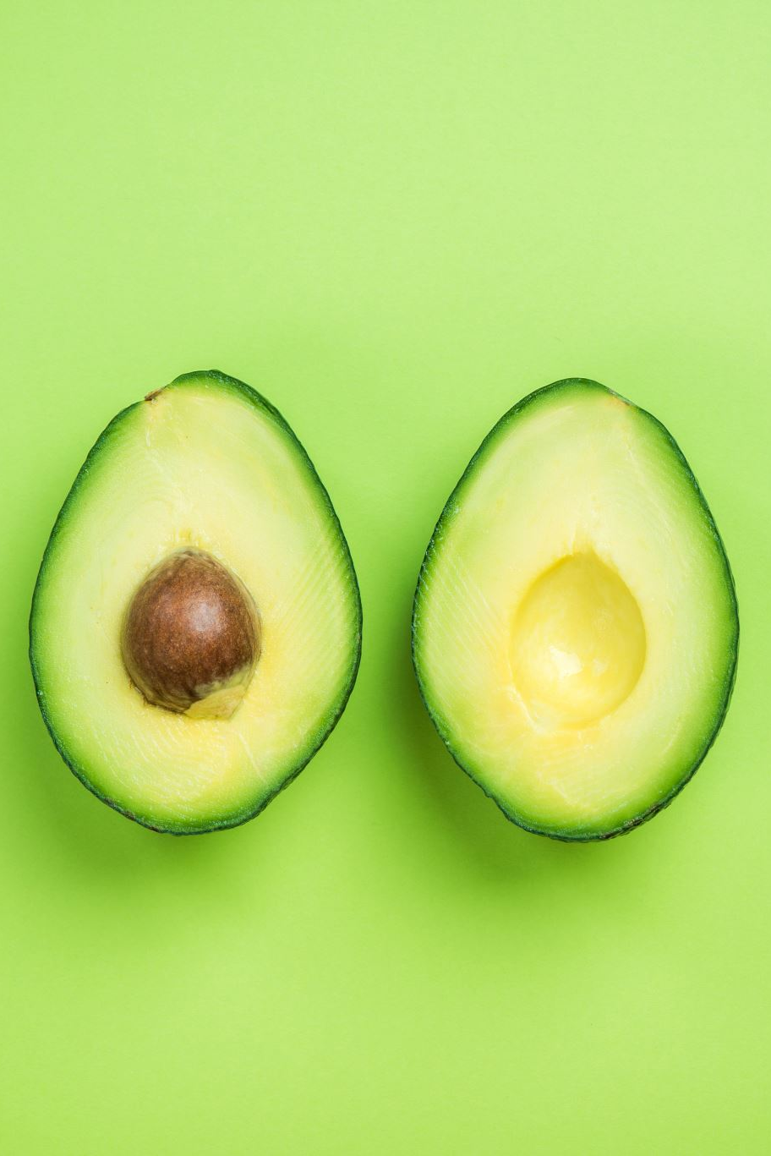
Introduction
Avocado's global importance: nutritional and economic value.
Diseases affecting productivity (e.g., root rot, laurel wilt).
Limitations of traditional detection methods.
Transition to IoT-enabled precision agriculture.
https://www.statista.com/statistics/593211/global-avocado-production-by-country/

Slide 3
Workflow
Project Selection, November
Decided on a smart agriculture project after meeting with Dr.Naomi.
1
Meeting With Keren, November
Obtained suggestions and review from a farm manager.
2
Research, November - December
Conducted a literature review on smart agriculture technologies.
3
Stakeholder Meetings, November – January
Held four meetings to refine the project idea and clarify requirements.
4
Final Idea, December
Chose early disease detection for Avocado trees as the focus.
5
Documentation, November - January
Writing the project book and planning for Phase B.
6

Slide 4
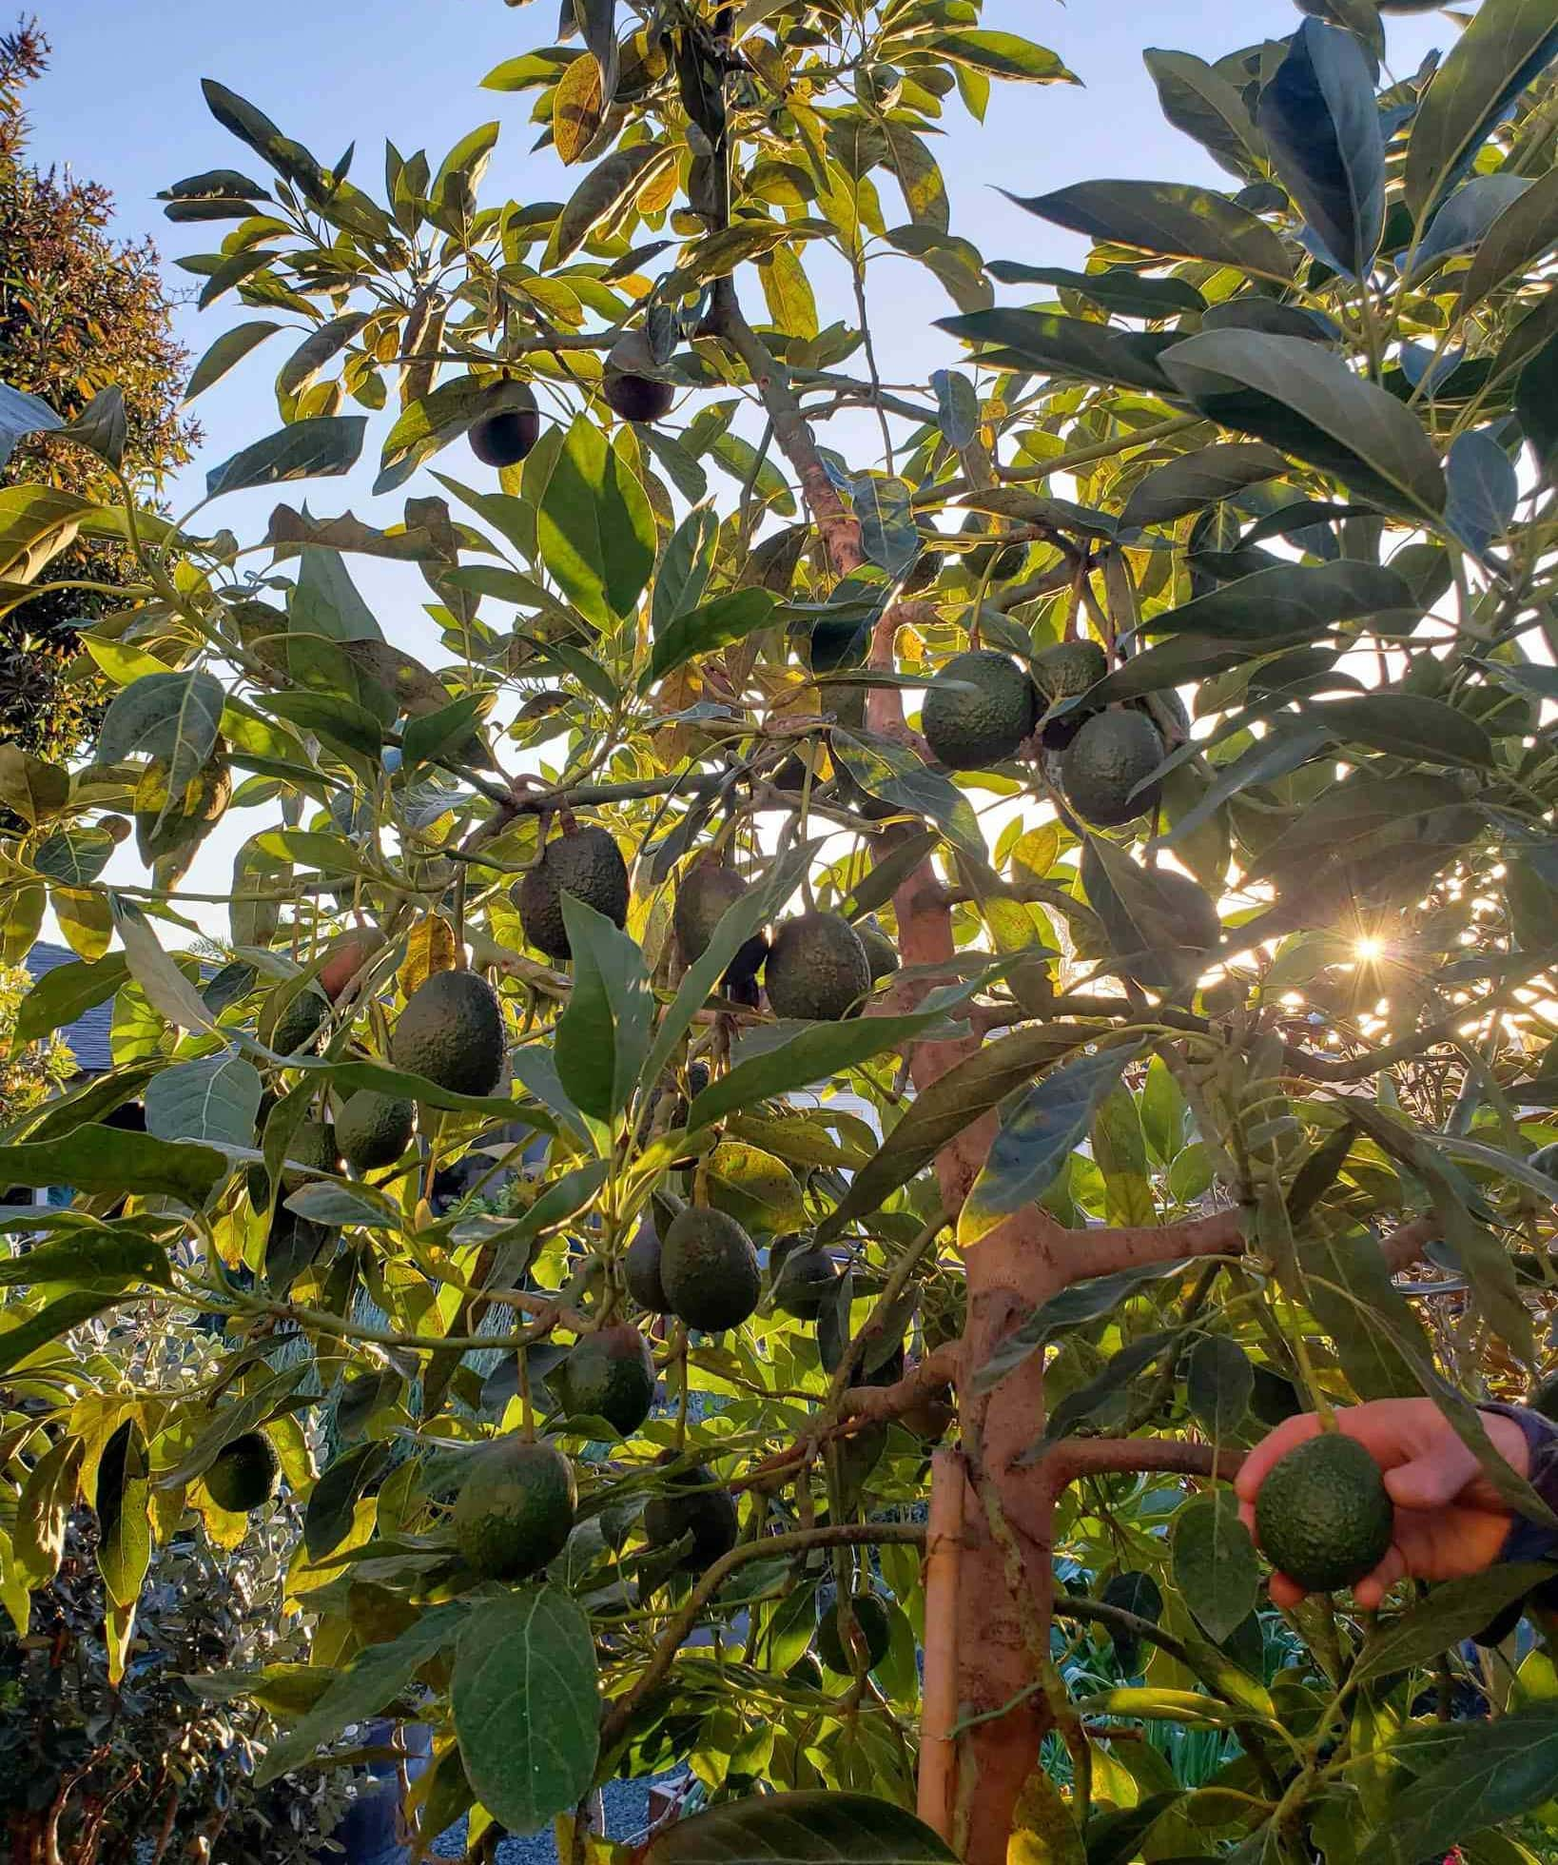
Avocado Tree Diseases – Part 1
A Healthy Avocado Tree
https://homesteadandchill.com/how-to-grow-avocados/

Slide 5
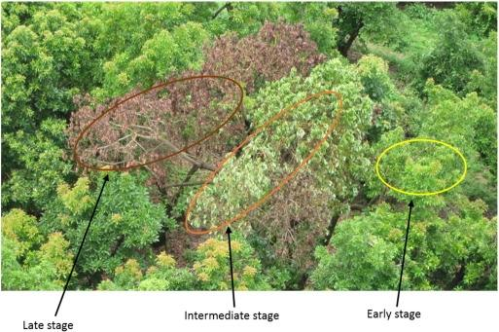
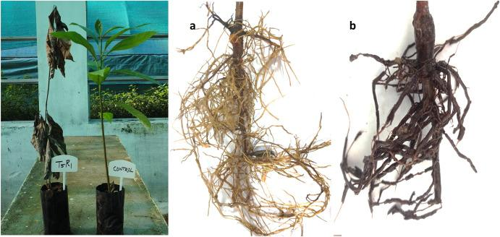
Avocado Tree Diseases – Part 2
Laurel Wilt Disease
Root Rot Disease
Ayyandurai, M., Theradimani, M., Harish, S., Manonmani, K., Madhu, G. S., Raja, I. Y., ... & Pushpam, A. K. (2024). Bioprospecting of microbial agents and their metabolites as potential inhibitors of Phytophthora cinnamomi, the causal agent of avocado root rot. Physiological and Molecular Plant Pathology, 133, 102362.
https://ucanr.edu/blogs/blogcore/postdetail.cfm?postnum=24850

Slide 6




Problem Statement
High susceptibility of avocado trees to diseases.
Challenges with early-stage disease detection.
Manual methods: time-consuming and error-prone.
Economic losses in preharvest, harvest, and packinghouse stages.
https://www.statista.com/statistics/593211/global-avocado-production-by-country/
https://greenarborists.com/five-common-diseases-of-avocado-trees/

Slide 7




Objectives
Develop a real-time IoT-based disease detection system.
Integrate environmental monitoring with image analysis.
Enhance precision and reliability in avocado farming.
Promote sustainable and data-driven agricultural practices.

Slide 8
Proposed Solution
System:
Web application enhances accessibility and greater efficiency.
Sensor integration for real-time data collection.
Machine learning for disease detection.
Data and image analysis.
Key Features:
Alerts and actionable insights.
Real-time updates.
Disease-specific recommendations.

Slide 9
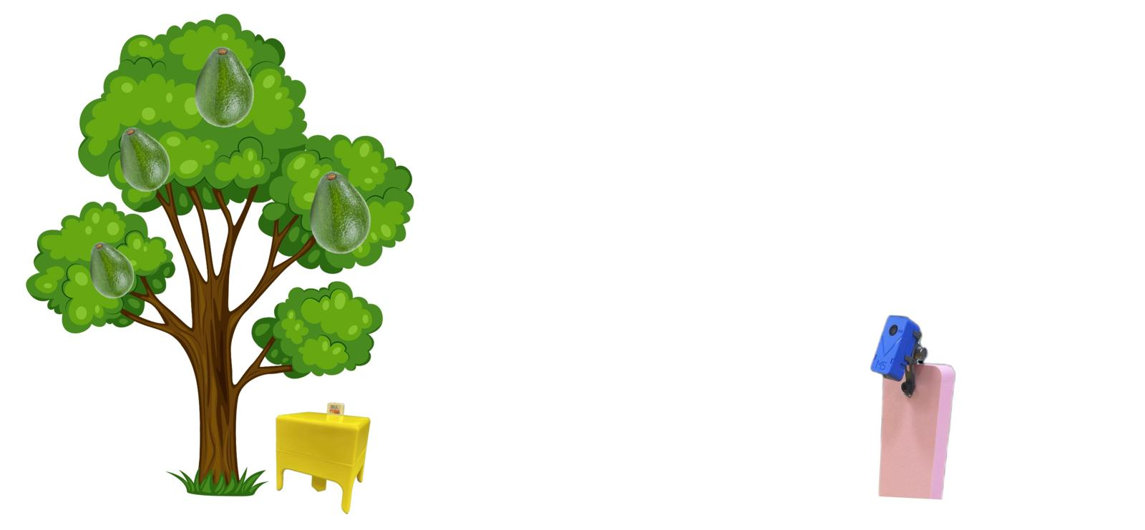
Sensor Bracket Demonstration

Slide 10
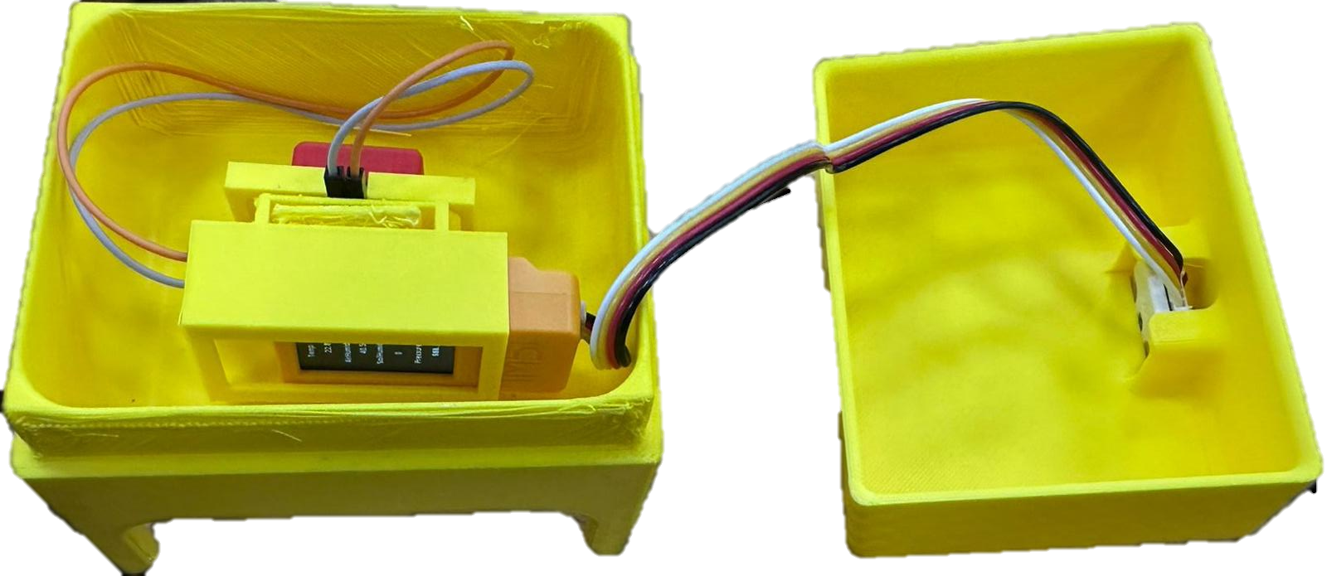
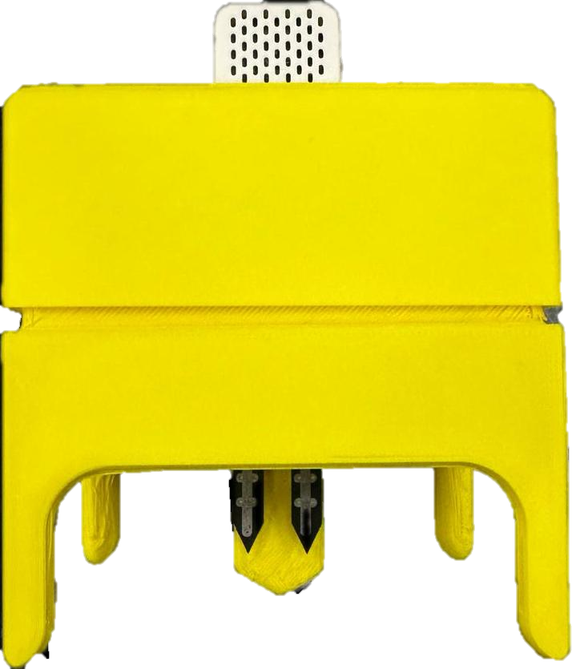
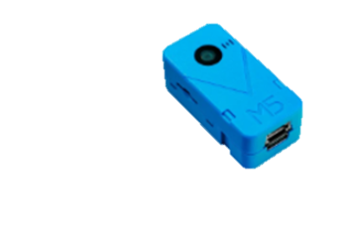
Hardware Model
Air Moisture Sensor
The Sensor Bracket Model Developed By Mechanical Engineering Students
M5Stack
Unit V2
Soil Moisture Sensor

Slide 11
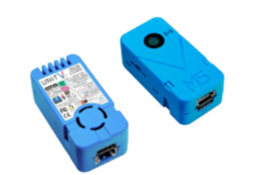
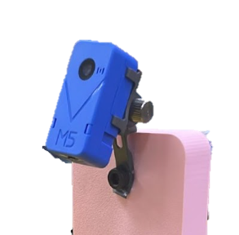
Machine Learning Model
Real-time image analysis using lightweight CNN – ShuffleNet V2.
Helps to facilitates applications.
leverages in computational efficiency to analyze high-resolution images of crops.
Provides a balance between speed and accuracy.
Wang, C., Liu, B., Liu, L., Zhu, Y., Hou, J., Liu, P., & Li, X. (2021). A review of deep learning used in the hyperspectral image analysis for agriculture. Artificial Intelligence Review, 54(7), 5205-5253.‏

Slide 12
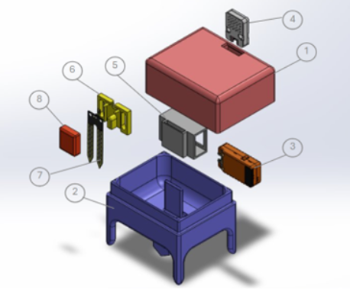
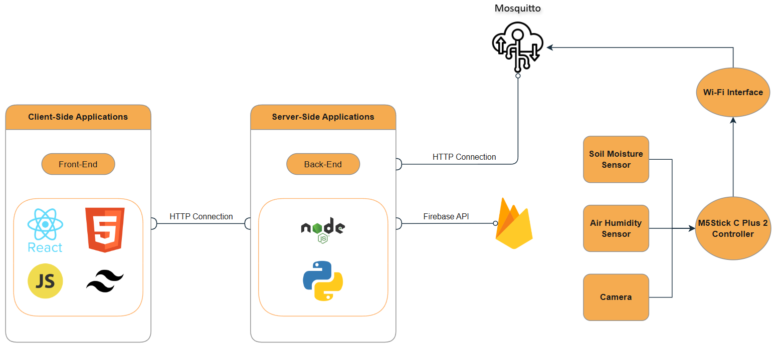
System Architecture

Slide 13
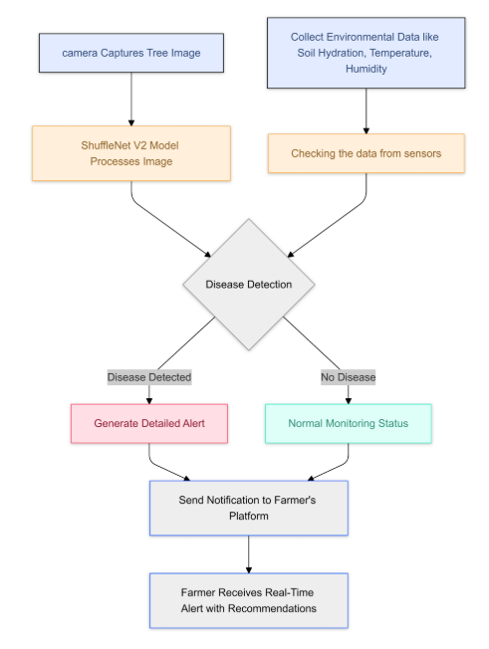
Algorithm
Sensors and cameras collect and analyze environmental and tree health data, stored in the cloud.
Embedded machine learning detects diseases like root rot directly on cameras.
Integrated data analysis provides a comprehensive view of field conditions.
Farmers receive actionable alerts and recommendations for irrigation and disease management.
Real-time updates enable proactive decisions to optimize tree health and productivity.

Slide 14
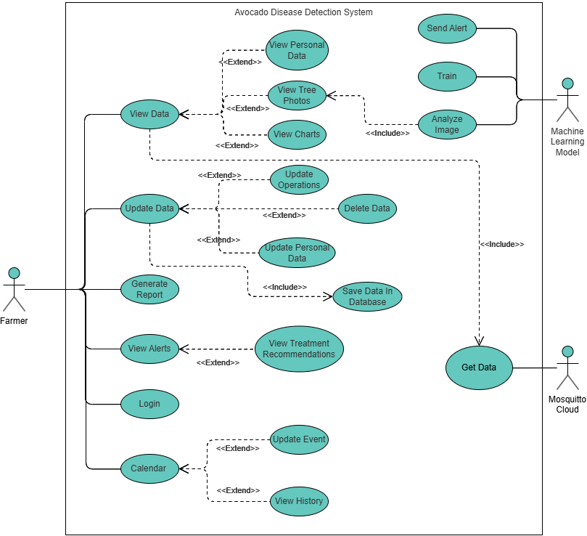
Use Case Diagram

Slide 15
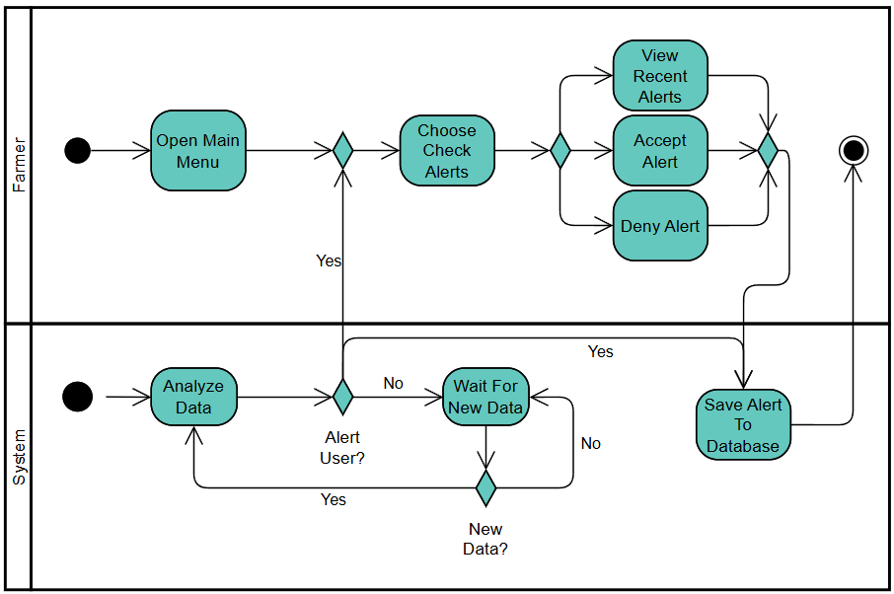
Activity Diagram
Check Alerts

Slide 16
Functional & Non-Functional Requirements
 | Functional Requirement
1 | The system should classify images into predefined disease categories or "healthy" using machine learning models.
2 | The system should store historical data for trend analysis and predictive modeling.
3 | The system should show notifications for users when new data has been fetched.
 | Non-Functional Requirements | Type
1 | The system shall be able to handle data from more than 1 sensor simultaneously without performance degradation. | Performance
2 | The system shall maintain an uptime of 99%, ensuring minimal downtime for data access and processing. | Availability
3 | The system shall ensure accurate data transmission with no error rate | Reliability

Slide 17
Challenges
Environmental interference affecting sensor accuracy.
Limited labeled datasets for machine learning models.
Maintaining low latency with high data volumes.
Farmers ability of using technology.
Managing the energy consumption of IoT devices.
Conducting thorough real-world testing to validate the system's effectiveness.

Slide 18
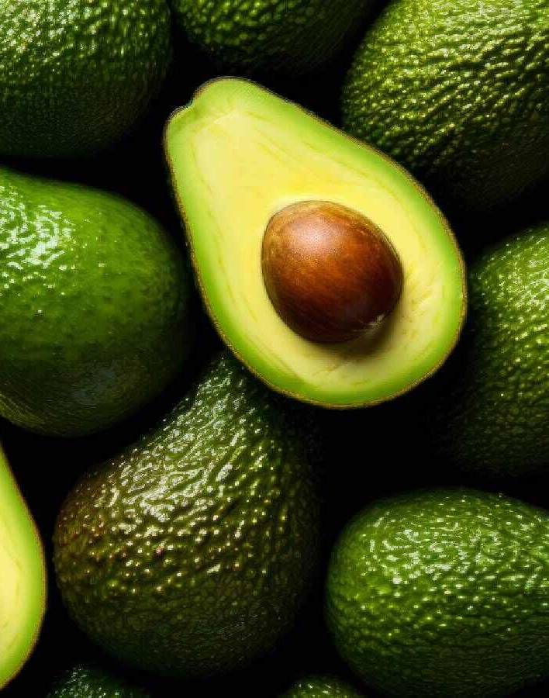

Thank you!
Questions?

